Slide 1
Service-oriented architecture
1. What is SOA? What is not SOA?
2. Why we need SOA? – Advantages of SOA
3. Drawbacks of SOA

Slide 2
What is SOA?
SOA has become a well-known and somewhat divisive acronym. If one asks two people to define SOA is likely to receive two different, possibly conflicting, answers.
SOAs are like snowflakes – no two are alike( David Linthicum – Consultant)

Slide 3
What is SOA?
In many ways SOA is a bit like John Godfrey Saxe’s poem about the blind men and the elephant. Six blind men encounter an elephant – each of the men then describes the elephant differently because they are influenced by their individual experiences:
The man touching the trunk believes it to be a snake
The man touching the elephant’s side believe it to be a wall etc etc.

Slide 4
What is SOA?
There is no widely agreed upon definition of SOA other than its literal translation.
Following sentences are trying to “catch” the substance of SOA –
-1) SOA would be better named “interface-oriented architecture”. SOA is a relationship of services and service consumers, both software modules large enough to represent a complete business function.
-2) SOA is an architectural design pattern that concerns itself with defining “loosely-coupled” relationship between producers and consumers. (loosely-coupled I will explain in following slides)

Slide 5
What is SOA?
…my thoughts …
SOA is nothing new. It is all about good design and “common sense”.
Good designed existing APIs most probably are in the “SOA manner” or are very easy to “wrap it” for SOA.
SOA is about defining as the public interface of an API only functions with clear and indubitable business value, clear business interface and nothing more. Even better if this interface is simple and straightforward. These exposed methods will be called services. The “SOA server” should not keep any state. This means that the services should be as independent as possible one of each other and the only dependency acceptable should be “business dependency”. If for “chargeCustomer(Integer customerId)” I need to “createCustomer(Customer c)” first it is OK. Any technical dependency is not acceptable in the exposed services. Even “business dependencies” should be investigated well maybe a better understanding of the business field will minimize even these ones. Less dependencies between services = better.
Any technical service which has disputable/unclear business value should not be exposed.
This slide is the first interpretation for “loosely-coupled” next will come in following slides.

Slide 6
What is SOA?
…from the books again....
  Services are autonomous
Services are entities that are independently deployed, versioned, and managed. Developers should avoid making assumptions regarding the space between service boundaries since this space is much more likely to change than the boundaries themselves. For example, service boundaries should be static to minimize the impact of versioning to the consumer. While boundaries of a service are fairly stable, the service’s deployment options regarding policy, physical location or network topology is likely to change. T
The architectural concepts associated with SOA enable loose coupling. Loose coupling is the fundamental principle behind SOA, enabling us to summaries up the benefit of SOA in a single word: agility.

Slide 7
What is SOA?
…me again…..
How to evaluate “good SOA” and “bad SOA”?
After you finish to define the SOA interface for your software go to your client which has 0 technical/programming knowledge but knows everything about his business field. If he will be able to understand from the first read each and every service exposed it means that you have the perfect “SOA design”. If it is not the case it means that something is wrong and you have to refine the interface ( it is better to involve the client with business knowledge in this process).

Slide 8
What is not SOA?
SOA does not mean Web-Services, . Net, J2EE, CORBA, DCOM, XML-Rpc or ebXML. Instead these are technologies that can be used to “deploy” a SOA implementation. And most probably are not the only way to deploy services.

Slide 9
Why we need SOA
There are many benefits of SOA, I will explain here the most important 3 from my point of view.
1) Applications easier to integrate – very relevant for Amdocs.
2) Applications easier to extend/customize – very relevant for Amdocs
3) Mashup-s applications. Not so relevant for Amdocs but intersting to know.

Slide 10
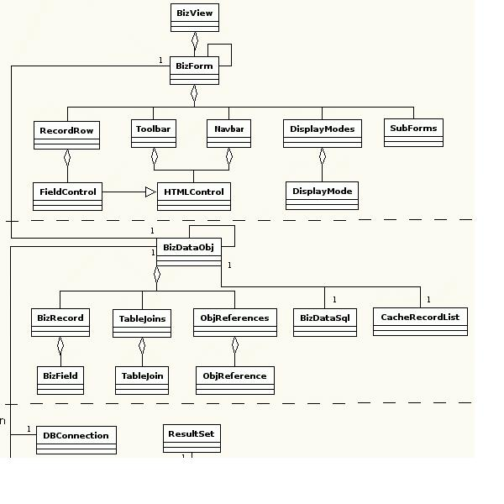
Easier to integrate
Cobol app.(Amdocs Ensemble)
c/c++ lang app.(IBM – ERP)
Smalltalk app.(People Soft HR)
Java app.(Oracle CRM)

Slide 11
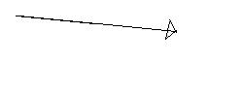
Easier to integrate
File1.xml
File2.xml
File3.xml
File4.xml
File5.xml
File6.xml
File7.xml
File8.xml
File9.xml…
…
File999.xml
Cobol app.
c/c++ lang app.
Smalltalk app.
Java app.

Slide 12
Easier to integrate
Of course what I presented is a little bit exaggerated and there are some other inter-app communication patterns like a broker (TRB) or JMS etc but the problem remains.
It is very difficult to integrate big and complicated legacy systems which in the happy situations are all from the same corporation but in most of the cases are from different vendors (SAP, Oracle financial, Amdocs), different tehnologies(70’s SmallTalk, 80s Cobol, 90s c/c++ or 2000’s Java).

Slide 13
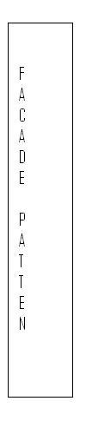
Easier to integrate – SOA approach
SOA services-web service
or something else
createCustomer()
getAllCustomers()
chargeCustomer()
other clear defined business services

Slide 14
Easier to customize/extend applications
For explaining better the advantages of SOA in customizing applications a new term should be introduced: orchestration of services.
SOAs build applications out of software services. Services are relatively large, intrinsically unassociated units of functionality, which have no calls to each other embedded in them. They typically implement functionalities most humans would recognize as a service, such as filling out an online application for an account, viewing an online bank statement, or placing an online book or airline ticket order. Instead of services embedding calls to each other in their source code, protocols are defined which describe how one or more services can talk to each other. This architecture then relies on a business process expert to link and sequence services, in a process known as orchestration, to meet a new or existing business system requirement.

Slide 15
Easier to customize/extend applications
High-level languages such as BPEL and specifications such as WS-CDL and WS-Coordination extend the service concept by providing a method of defining and supporting orchestration of fine grained services into more coarse-grained business services, which in turn can be incorporated into workflows and business processes implemented in composite applications.

Slide 16
Easier to customize/extend applications
Business Process Execution Language (or BPEL), is a business process modeling language.
The origins of BPEL can be traced to WSFL and XLANG. It is serialized in XML and aims to enable programming in the large. The concepts of programming in the large and programming in the small distinguish between two aspects of writing the type of long-running asynchronous processes that one typically sees in business processes
BPEL is an Orchestration language, not a choreography language (see Web Service Choreography). The primary difference between orchestration and choreography is scope. A choreography model provides a scope specifically focusing on the view of one participant (e.g. a peer to peer model). Instead, an orchestration model encompasses all parties and their associated interactions giving a global view of the system. This is basically also the difference between “programming in the large” and “programming in the small”.
BPEL was developed, by IBM and Microsoft, to compete with an earlier language, BPML, developed by BPMI.org (Business Process Management Initiative).
Today, the differences between BPEL and BPML in the past are largely academic. BPEL syntax won out. BPML semantics won out. The power of IBM and Microsoft carried the day with the name BPEL. BPEL is evolving slowly into BPML. This is inevitable, since BPML was formally complete.

Slide 17
Easier to customize/extend applications
In June 2007, Active Endpoints, Adobe, BEA, IBM, Oracle and SAP published the BPEL4People and WS-HumanTask specifications, which describe how human interaction in BPEL processes can be implemented.
BPEL focuses on how only computer driven services should interact. But there are cases in which human intervention in needed in the middle of the flow. BPEL4People is an extension of BPEL which tries to define how human can interfere in flows compose of business services.

Slide 18
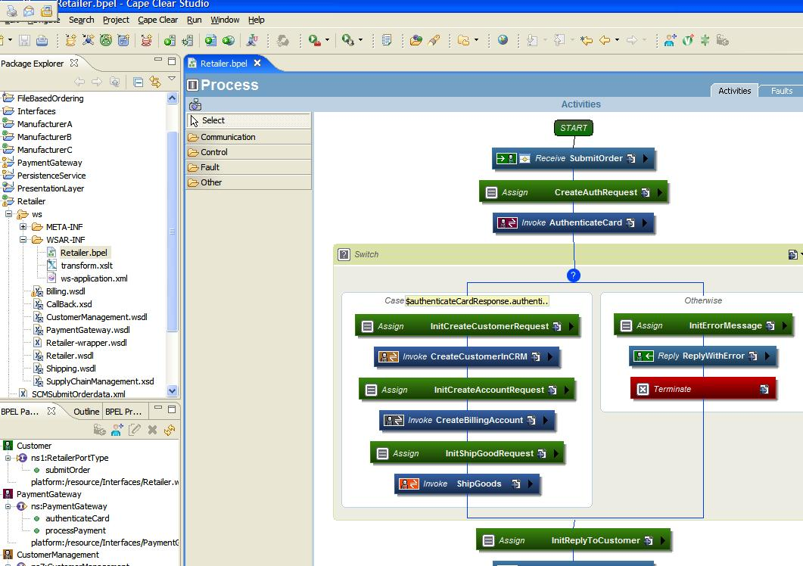

Slide 19
Easier to customize/extend applications
So how “orchestration” between existing exposed services can make the customization/implementation easier?
The answer is simple. Implementation teams will take the “generic/core” product and will study which are the exposed services.
With the “requirements” document and together with the client/business consultant (this is very important in SOA as the exposed services are only about exposing “business value”) they will try to figure out how to “orchestrate” the existing
“core services” in the flows described in the requirements document.

Slide 20
Easier to customize/extend applications
In the final a new “scripted solution” will appear which the client will understand much better than existing solutions that he receives.
As the solution is “scripted/orchestrated” and not “hard coded” in cryptic code it is much like to be easier/less costly to extend/change as the business needs will change. This is equal with business agility( the capacity to change easier when the business model change). Current solutions are very difficult/costly to change/adapt to new business reality.

Slide 21
Easier to customize/extend applications
Of course there will be cases in which will be very difficult/maybe impossible to cover all the requirements scenarios with BPEL kind of scripting against services. So for this scenarios current approaches of taking the core product and extend/customize in classical way will be all the time available. But this cases is better to minimize. Maybe for such cases a question like “Should I improve/extend my set of exposed services in order to cover this new requirement??” will solve the problem more nicely. Still there will be cases in which classical approach will be better. Mostly this is because the set of exposed services should be kept simple and straightforward in order not to loose their initial scope( easier to be understood by business).

Slide 22
Mashups. What are these?
Mashups is about how to take advantage of existing data sources, and combine them to form a new and never-before imagined applications. Here are just a few examples of applications that have already been built, most of them by a sole developer.
Craig’s Real Estate List + Google Maps = Interactive maps showing you where apartments are for sale.
Google Maps + 911 call information = Visual representation of where crime is happening in real time.
Amazon + RSS = Feeds of product reviews that allow you to monitor your favorite products and find out when someone’s submitted a review, or when a product goes on sale.

Slide 23
Mashups. What are these?
Service-oriented architecture are slowly being adopted by major corporations, and once this happens, new services will begin to appear. With the proliferation of Web services comes the opportunity to combine these services in new and interesting ways.
Even currently all the major Amazon, Yahoo, Google, Microsoft have developer programs in which they expose as services( as web services) from many business areas.
For example Amazon is exposing most of it’s data as web services and even more. For example it has services similar with JMS which for a very small per use/fee can be used in order to build messaging applications. Another service from Amazon is that you can “rent hardware”. For example if interested Amdocs can conduct the full NFT of billing on Amazon’s rented hardware capabilities/servers. ☺.
Yahoo and Google have similar services in which they expose most of their well known “searching capabilities” as web services. And not only that. Many other information/data is exposed as services by this companies.
Combining (mashing) different services from different vendors is an endless source of very interesting applications that will start to appear in the near future.

Slide 24
Drawbacks of SOA
Attempted SOA will cause great successes and great failures on software projects. – Gartner.
“Users : Beware of Opportunistic Web Services Projects” – Service-oriented architecture built opportunistically and at as low cost as possible will be a disaster for enterprises’ software infrastructure – Gartner.
Some critics feel SOA is merely an obvious evolution of currently well-deployed architectures (open interface).

Slide 25
Drawbacks of SOA
SOA implementations can run slower than classical solutions. This difference can become even bigger on bad SOA designs.
For example SOA is saying that services should be as independent as possible. This means that in order to do this some time the same piece of code will be shared again and again/redundant between services in order to improve the “loosely coupling”. When this services will be orchestrated probably the speed will not be the best asset of the result. This issue can be handled with a very careful design of the exposed services. For sure some trade-offs will be done between “loosely coupling” – business value of the exposed services – simplicity of the services – performance will be done. The value of the SOA architect designer will come in finding the good proportions of these trade-offs. Good designers will find good trade-offs others will just make a bad design.

Slide 26
Drawbacks of SOA
Some SOA implementations very soon start to look as they are “underpowered”.
SOA is saying that the exposed services should be as straightforward and as business value as possible. Complicating the services will soon loose the advantages of SOA as we will finish again with old huge – complicated – inter related relation of classes/services that we have now. Because of that “underpowered” symptom will start to appear.
For example the service createCustomer(Customer c) exposed as a service by a CRM software. Creating a customer can be a very complex flow and we cannot expose all the complexity with the service. As service should be exposed only most common business scenarios and which are more likely to remain stable for a very long period. Doing this we trade the power of current solutions for the simplicity of SOA. Orchestrating simple services we will get only the most common flows of the business and because of that the sensation of “underpowered” will appear.
Form my point of view the solution to this is a “hybrid” architecture. This hybrid is the current complex class technical oriented powerful solution “wrapped” by a simple SOA façade. Most common business requirements will be achieved in implementation “by orchestrating” the SOA services with BPEL kind of scripting way.
More complex solutions/fancy requirements which are not possible to obtain with scripting/orchestrating of services will be deployed like now with directly extending/changing the complex class structure provided by the core projects.
Like this we will get the best from the both worlds.

